Slide 1
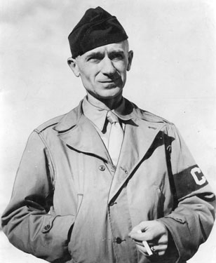
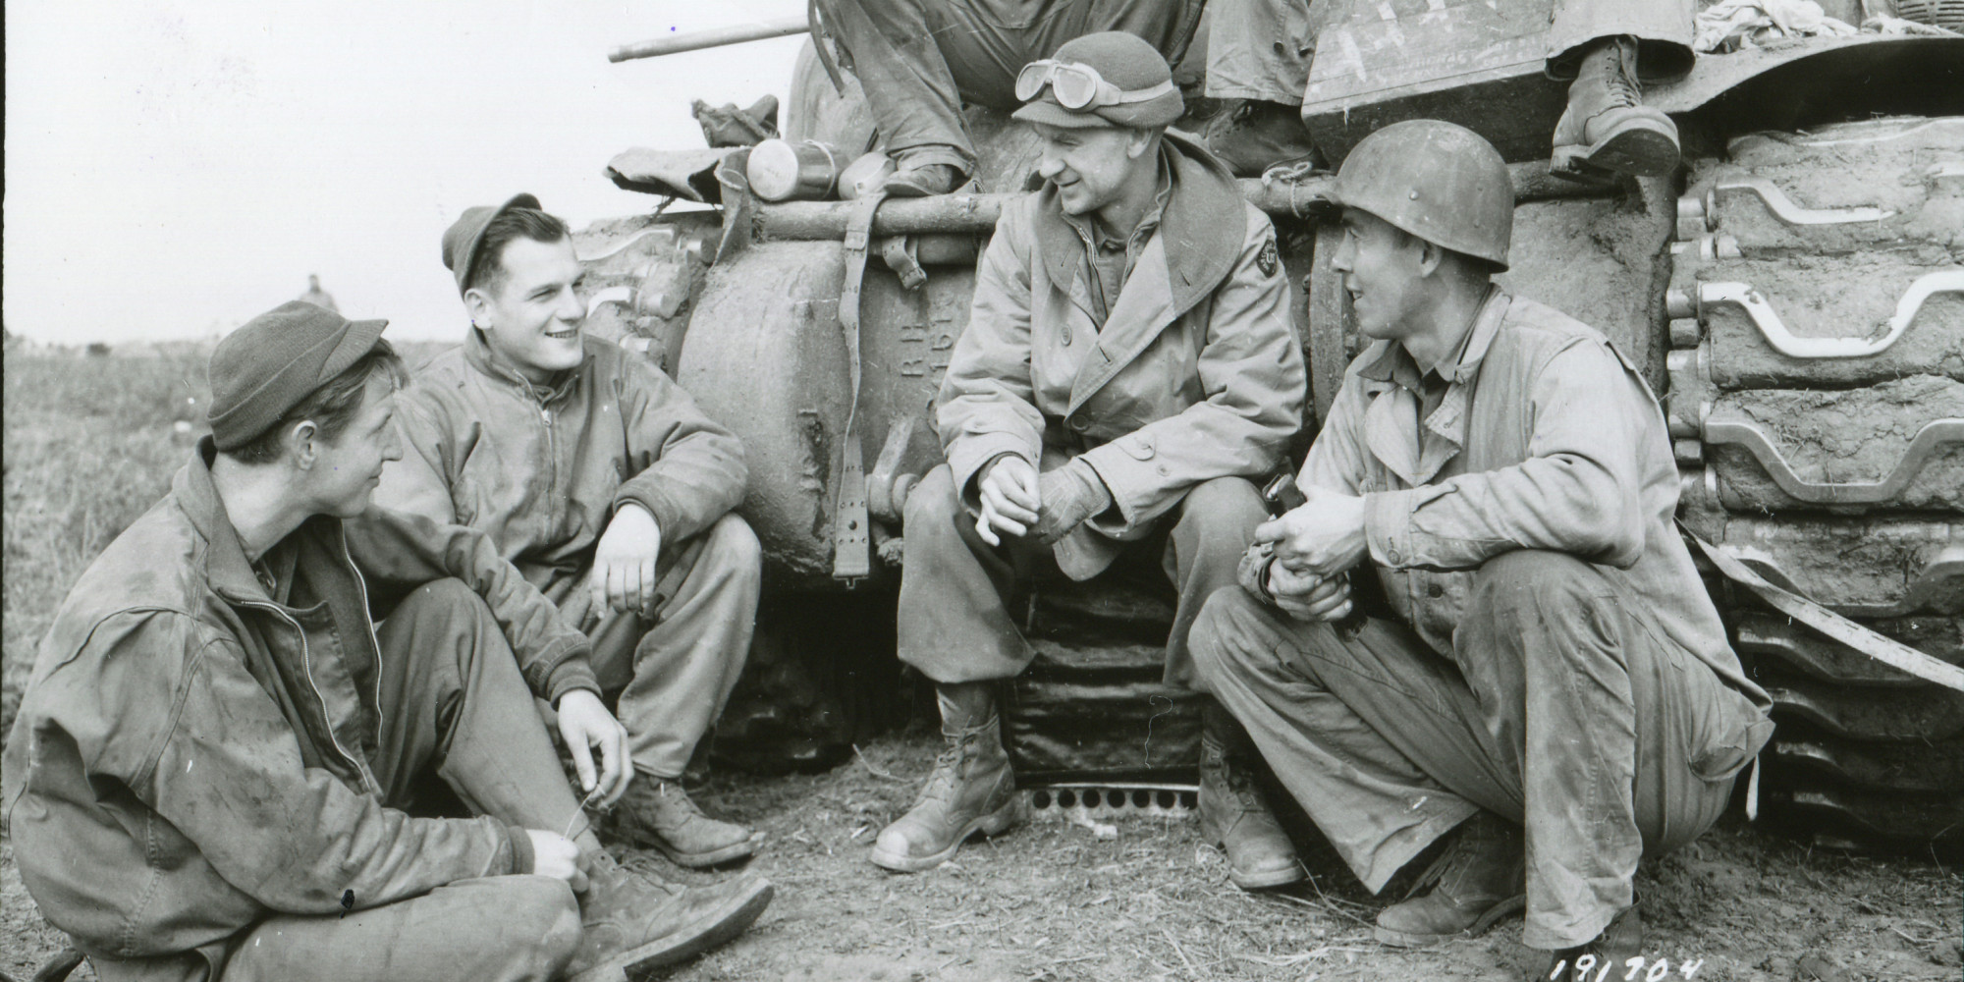
Ernie Pyle: A Friend to the G.I.
1900-1945
Shelley Grostefon
History of News
April 11, 2014

Slide 2
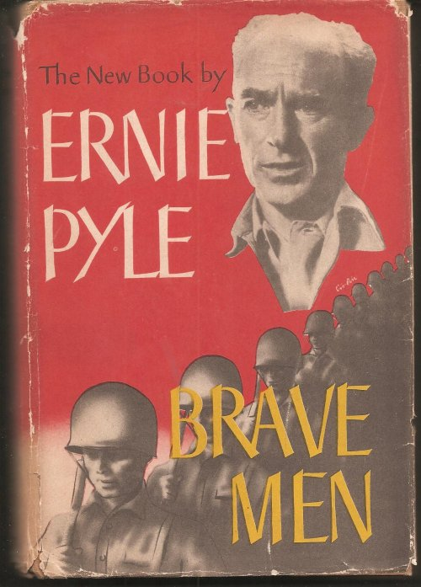
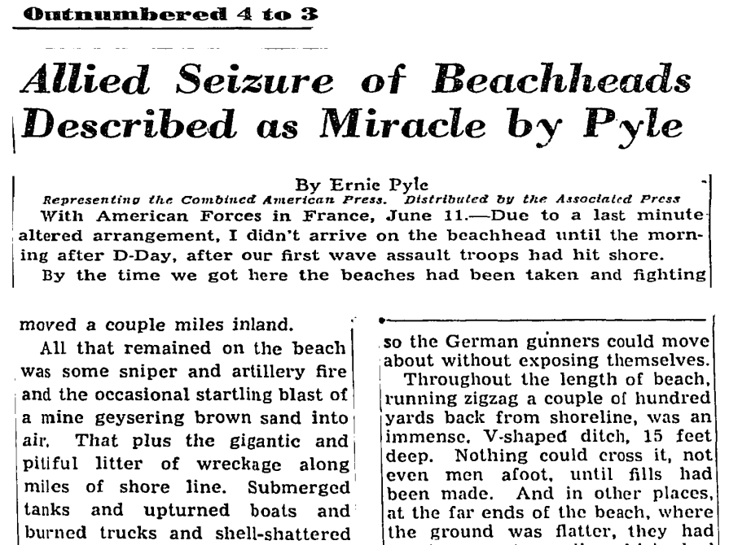
Introduction

Slide 3
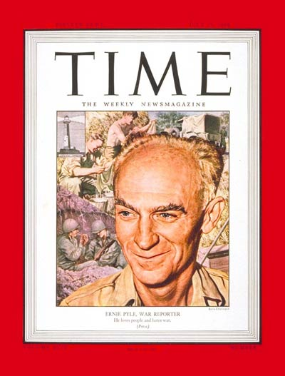
Historical Question
How did Pyle portray the war, especially compared to the writings of others and general trends of the press during WWII, and what was his impact?

Slide 4
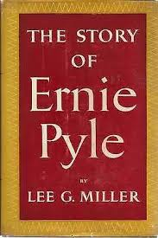
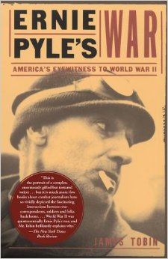
Historiography
Tobin (1997): View of Pyle’s life, focused more on his wartime writings and his impact
Miller (1950): Overview of Pyle’s life and career, includes many private letters

Slide 5
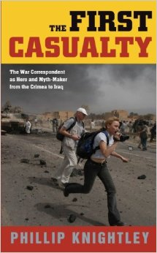
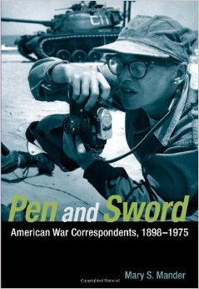
Historiography
Knightley (1975): Places Pyle’s writings into the larger themes of war reporting in WWII and comparing his reporting to others
Mander (2010): “The war reporter is a walking advertisement for the nation-state.”

Slide 6
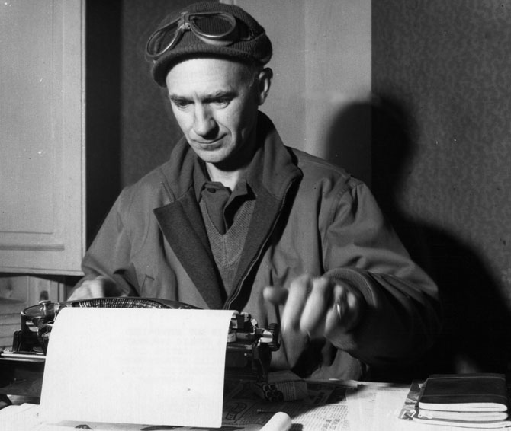
Historical Argument
Ernie Pyle’s anecdotal reporting brought the war home by translating combat into intimate stories of individual soldiers. He helped Americans to understand the meanings of war, but shifted focus away from the broader political and strategic dimensions of the war.

Slide 7
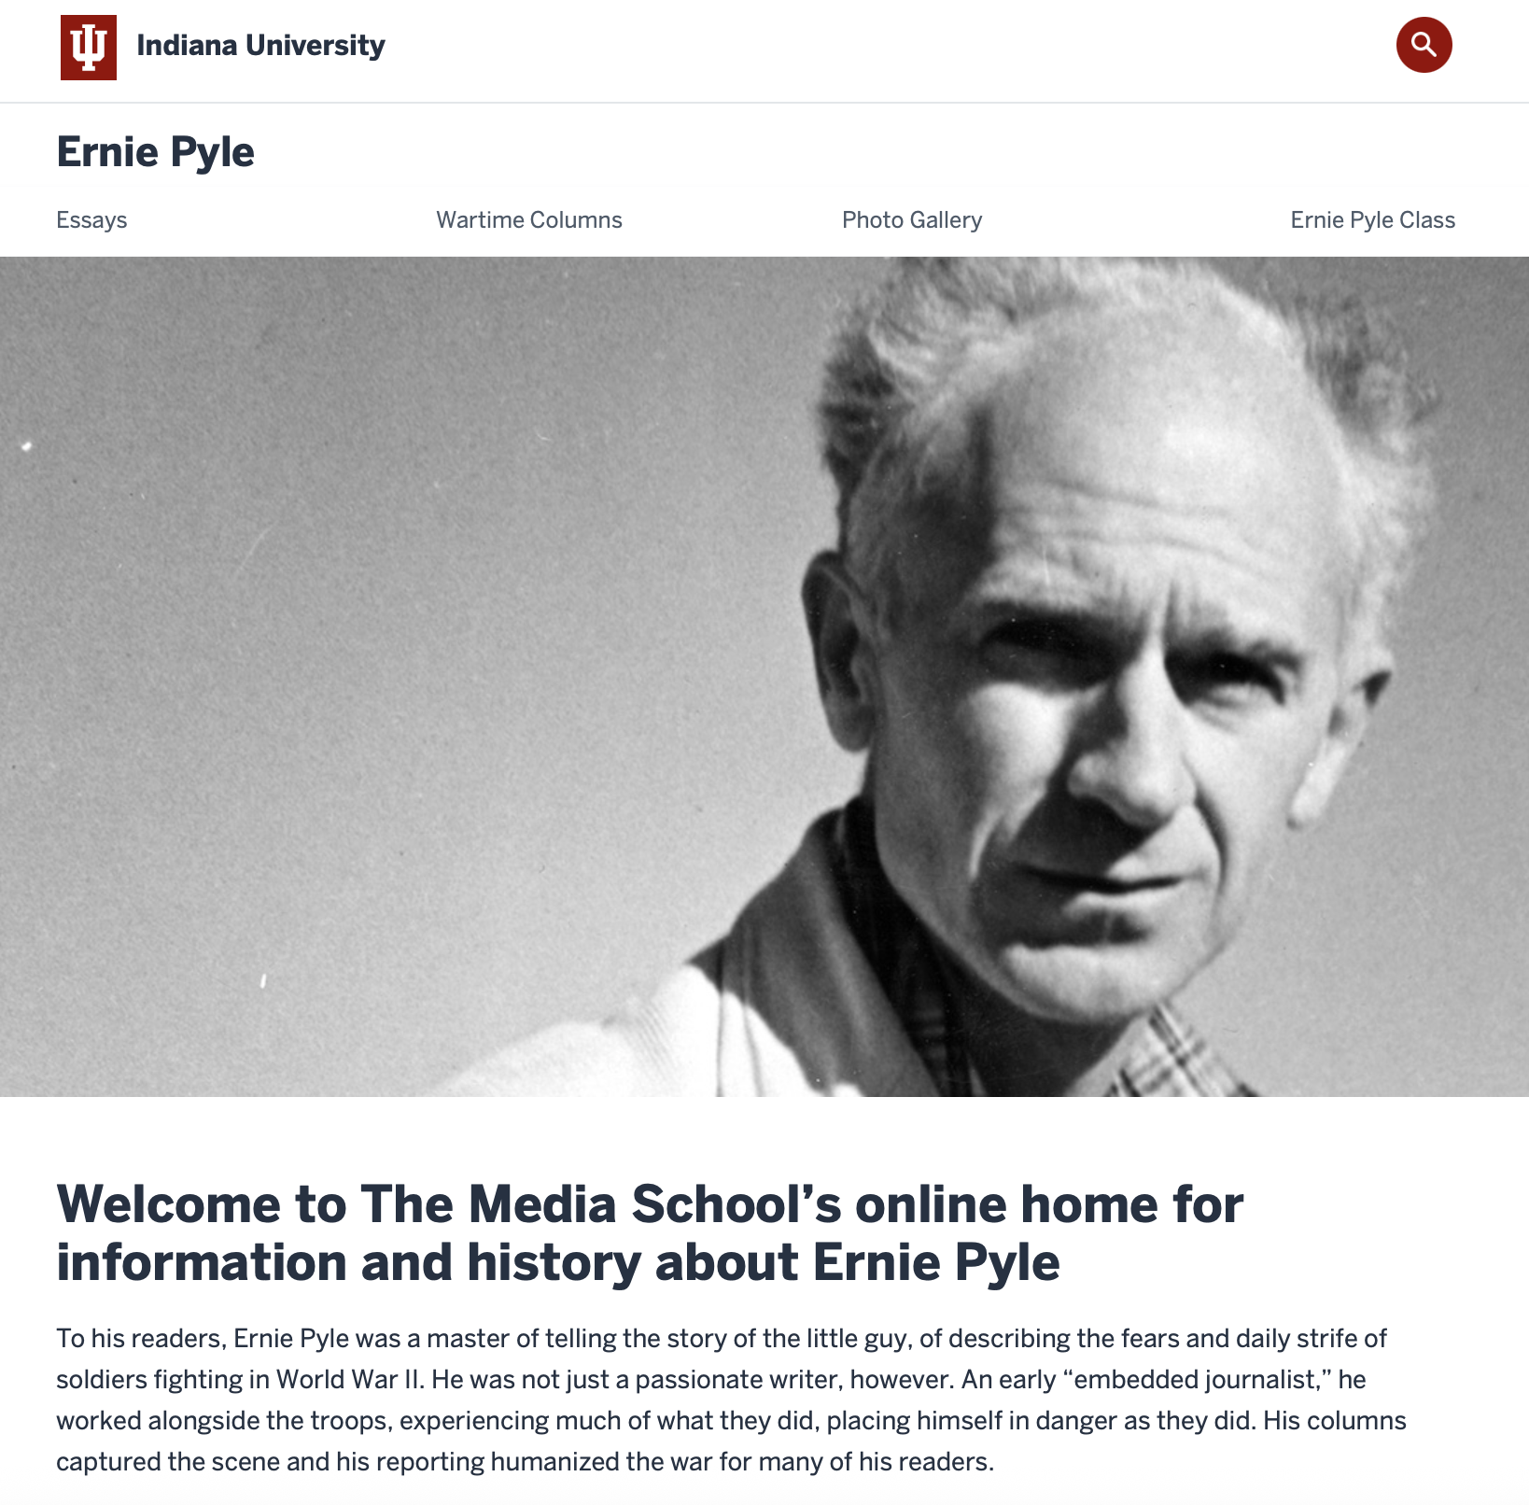
Primary Sources
Corpus: Forty columns of Ernie Pyle’s reporting from Scripps-Howard
Available at The Media School’s online home for information on Ernie Pyle at Indiana University

Slide 8
Examples
At The Front Lines in Italy
January 10, 1944
In this war I have known a lot of officers who were loved and respected by the soldiers under them. But never have I crossed the trail of any man as beloved as Capt. Henry T. Waskow of Belton, Texas.
Focus on individuals

Slide 9
Examples
The God-Damned Infantry
May 2, 1943
I love the infantry because they are the underdogs. They are the mud-rain-frost-and-wind boys. They have no comforts, and they even learn to live without the necessities. And in the end they are the guys that wars can’t be won without.
One of his most famous columns
The view of the war from the front lines

Slide 10
Examples
On Victory in Europe
April 18, 1945 (posthumous)
Last summer I wrote that I hoped the end of the war could be a gigantic relief, but not an elation. In the joyousness of high spirits it is so easy for us to forget the dead. Those who are gone would not wish themselves to be a millstone of gloom around our necks.
How to confront the end of war?

Slide 11
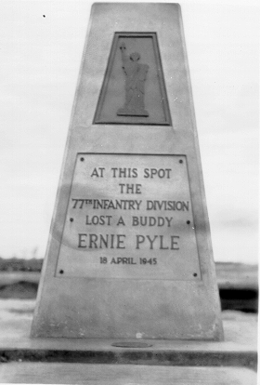
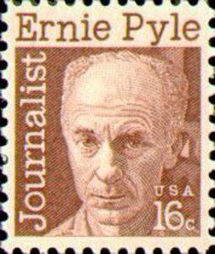
Conclusion

